Slide 1
Summer Research Plan
Mingyu MA

Slide 2
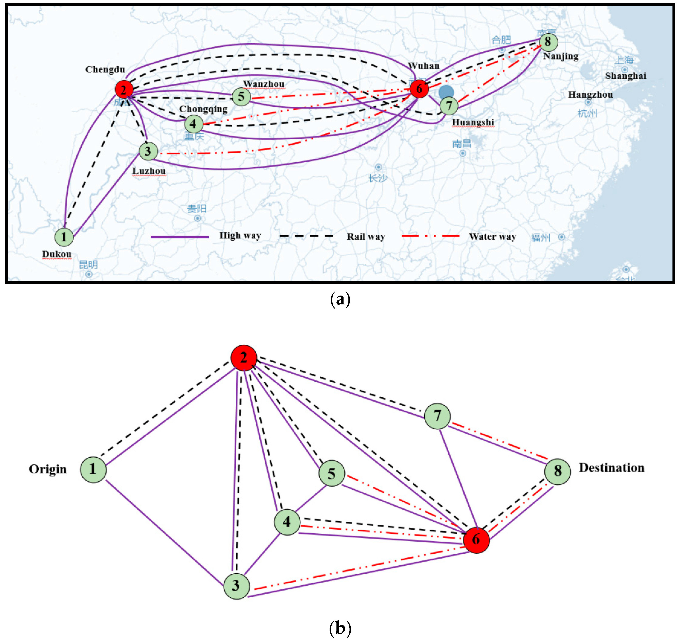
Our Project: 3D Geometric Graph Visualization
This research concerns about setting up the representation and providing visualization of geometric graph.
Design a new algorithm which is used to calculate the coordinates of all nodes that derive a best solution.
Design a new visual representation scheme that can visualize the output graph clearly. Visualization results must be readable and comprehensible
Figure .4 (a) Transport network of case and (b) transportation network topology.

Slide 3
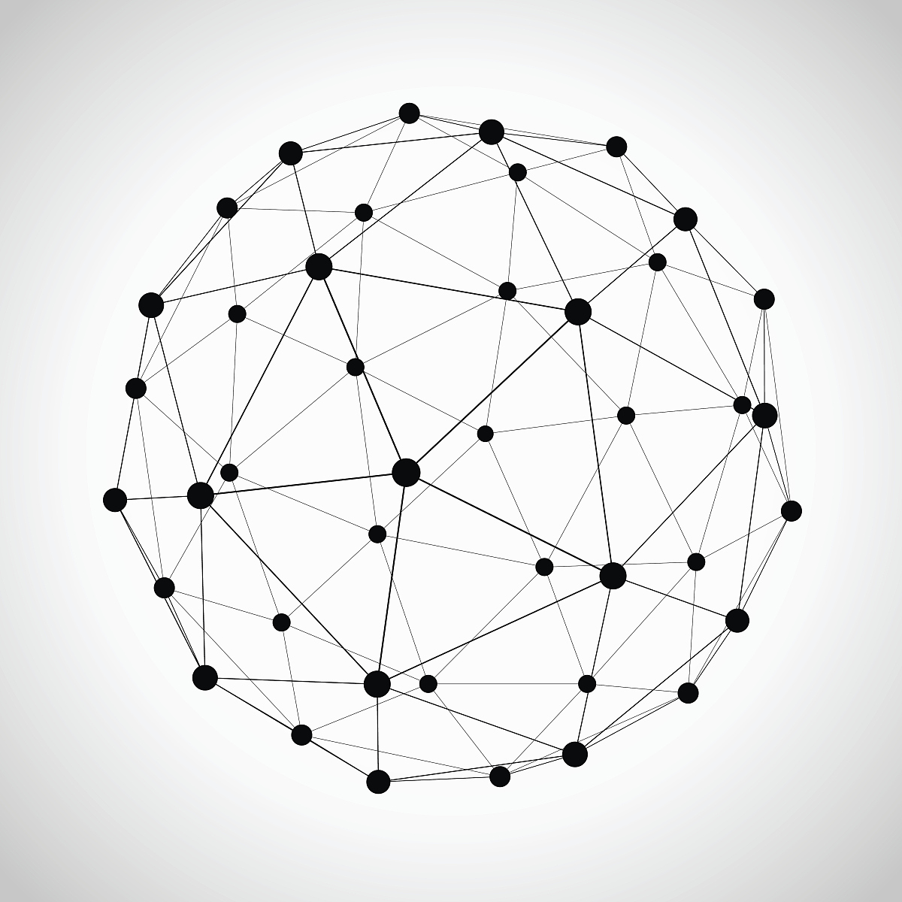
Summer Period Goal
Improving the current visualizing solution in 2D space(half a month).
Developing 3D visual solution for this project.
Cooperating with another group to execute programming work according to the common research progress.
Sample 3D geometric graph

Slide 4
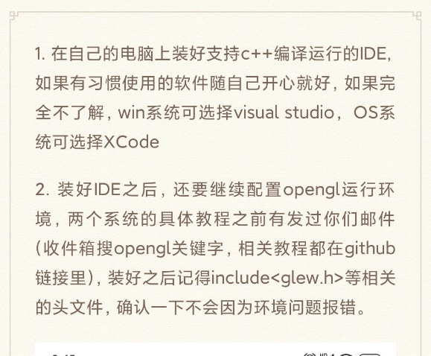
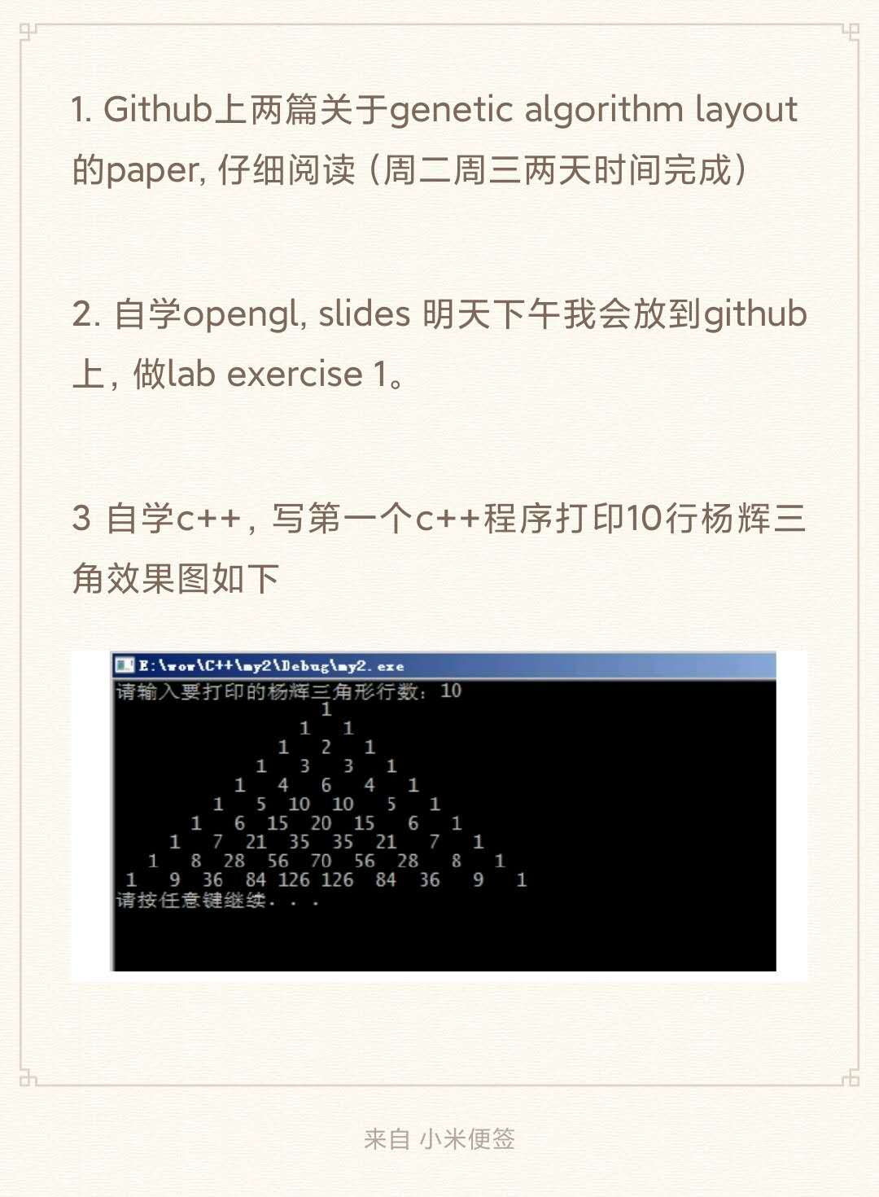
Assignments
Every Thursday we will have a regular meeting, current research progress and problems will be raised during the meeting.
I will release daily tasks in our wechat group, and the progress of these tasks will be checked at around 9:00 PM everyday.
3. I will also distribute different tasks to different members according their personal ability.
Example daily task notes

